Slide 1
Lecture 1: Introduction to GIS

Slide 2

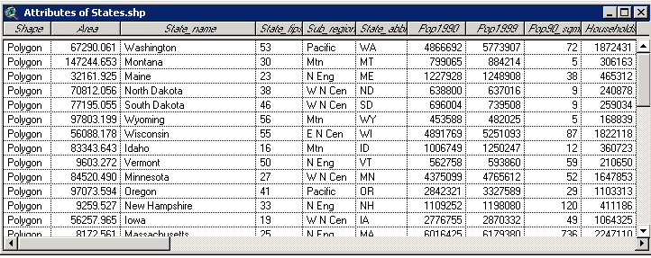
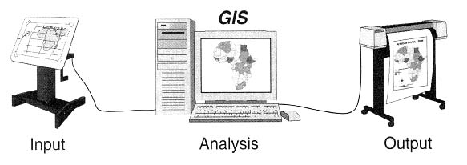
What does GIS stand for?
Geographic
(Geography)
Information
System
Notes:
Geography – refers to the Earth surface and near surface.
Spatial refers to any space including geographic
Geospatial is synonymous with geographic.

Slide 3
What is a Geographic Information System?
Geographic Information System (GIS) – A computer-based system for the collection, storage, organization, maintenance, and analysis of spatially-referenced data, and the output of spatially-referenced information.
Data – Any collection of related facts; the basic elements of information.
Information - Data that have been processed to be useful; provides answers to "who", "what", "where", and "when" questions
Information can only come from accurate data (GIGO).
Notes:
T

Slide 4
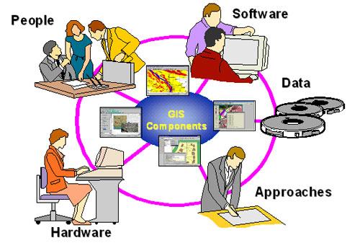
What are the components of a GIS?
We understand GIS to be computer facilitated system
But it is NOT only software and
hardware
Also includes:
Data – both spatial and aspatial
Trained personnel
Supporting Institution
Protocols for use

Slide 5
GIS Software Tools
GIS started at universities as research tools – Harvard,
Yale, Minnesota, Clark University
GIS software have evolved to robust (sort of) tools
capable of a wide variety of tasks
Primary flavors
ESRI (ArcGIS) Intergraph QGIS Bentley Map
Microimages Autocad MapInfo
ERDAS Idrisi Manifold Smallworld
GRASS GeoMedia AUTOCAD MAP 3D Maptitude

Slide 6
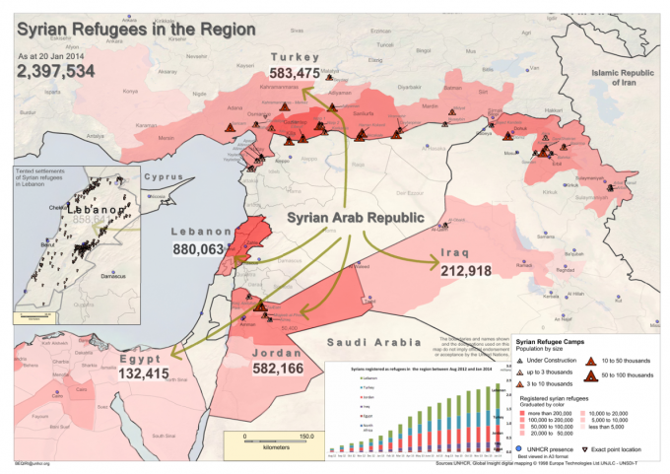
The Map

Slide 7
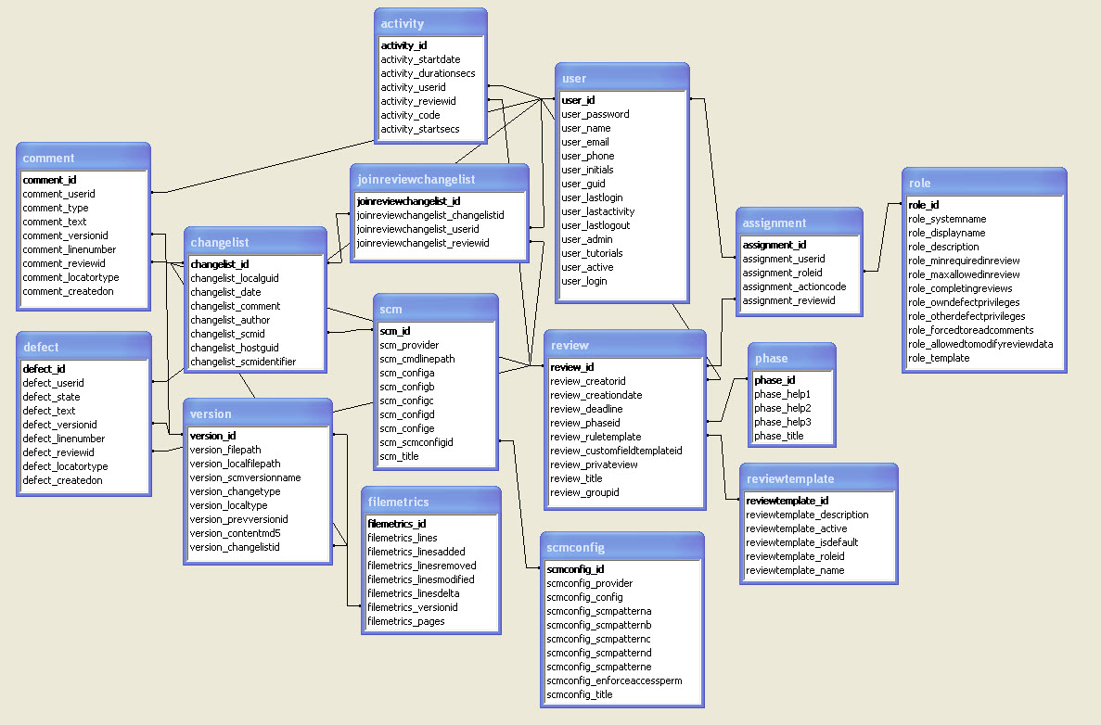
The Database

Slide 8
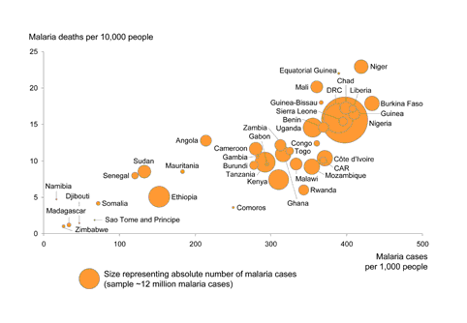
Other Features Graphs
Malarial Deaths per 10,000 People

Slide 9
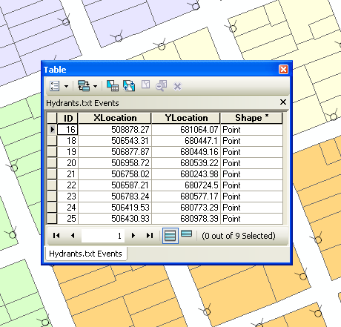
Other Features Tables
https://desktop.arcgis.com/en/arcmap/10.3/manage-data/tables/GUID-5A309AD2-B84E-4ECF-A475-7E4B492660EC-web.png

Slide 10
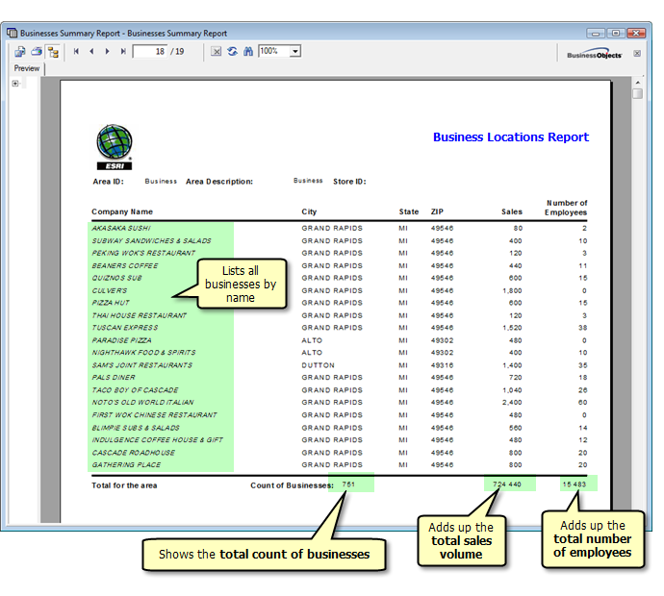
Other Features Reports
http://desktop.arcgis.com/en/arcmap/10.3/guide-books/extensions/business-analyst/GUID-389C0E81-9313-4C5C-94B0-51D7650E3B53-web.png

Slide 11
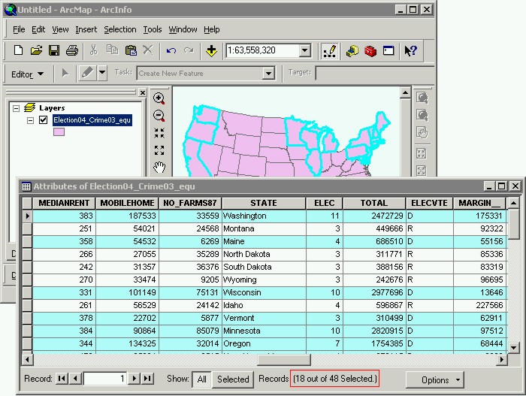
The Power of GIS
The interaction between the database and the map, along with the ability to create graphs, tables and reports.

Slide 12
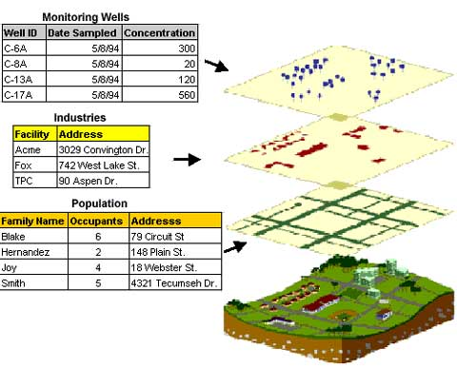
How does a GIS answer spatial questions?
GIS allows us to abstract information from the physical world and display it in layers or themes. It allows us to:
Input and edit both spatial and attribute data.
Display data on a screen or print a map.
Analyze the data for making decisions and searching for patterns.
Create models and ask “what if”.

Slide 13
What types of questions can be answered by a GIS?
Where are particular features found?
What geographic patterns exist?
Where have changes occurred over a specified time period?
Where do certain conditions apply?
What will be the implications if an organization takes a certain action?

Slide 14
What types of data are used in a GIS?
Coordinate data
Connection information
Descriptive information
Temporal information
Images
Documents
URL’s

Slide 15
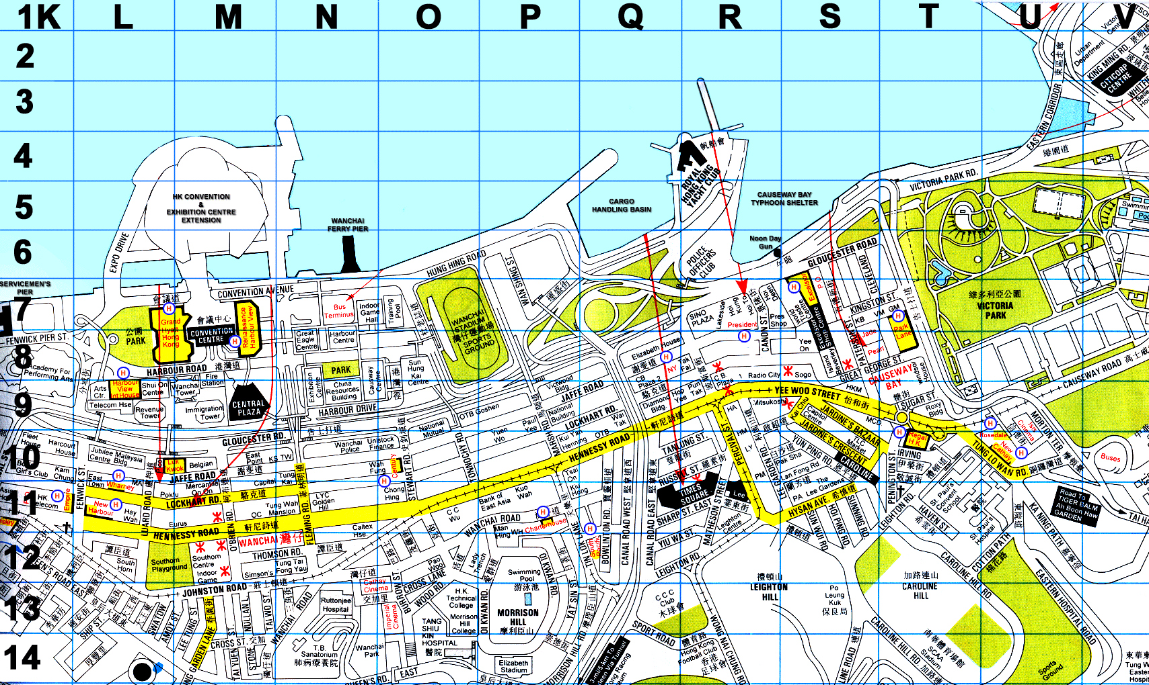
Coordinate Data for a GIS
Spatial data – you can attach coordinate information.
2D maps (X,Y)

Slide 16
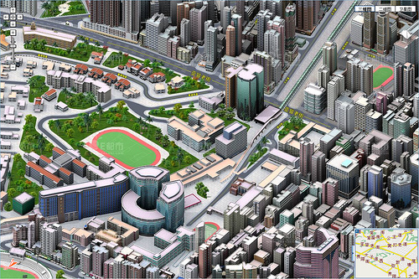
3D –Maps (X,Y,Z)

Slide 17
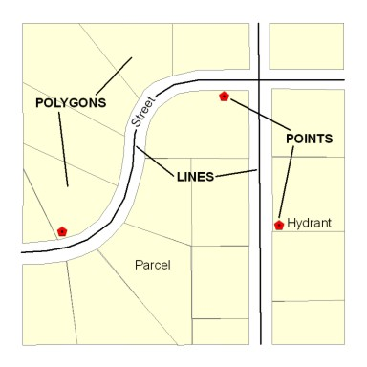
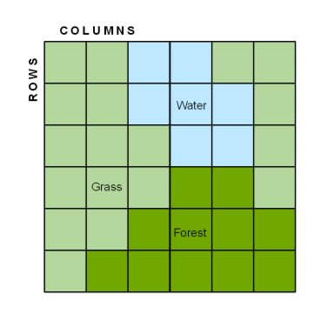
How is spatial data represented in a GIS?
Vectors
Raster
Points, Lines & Areas/Polygons
Grids/Tesselations

Slide 18
Applications of GIS
Urban Planning, Management & Policy
Zoning, subdivision planning
Land acquisition
Economic development
Code enforcement
Housing renovation programs
Emergency response
Crime analysis
Tax assessment
Environmental Sciences
Monitoring environmental risk
Modeling storm water runoff
Management of watersheds, floodplains,
wetlands, forests, aquifers
Environmental Impact Analysis
Hazardous or toxic facility siting
Groundwater modeling and contamination
tracking
Political Science
Redistricting
Analysis of election results
Predictive modeling
Civil Engineering/Utility
Locating underground facilities
Designing alignment for freeways, transit
Coordination of infrastructure maintenance
Business
Demographic Analysis
Market Penetration/ Share Analysis
Site Selection
Education Administration
Attendance Area Maintenance
Enrollment Projections
School Bus Routing
Real Estate
Neighborhood land prices
Traffic Impact Analysis
Determination of Highest and Best Use
Health Care
Epidemiology
Needs Analysis
Service Inventory

Slide 19
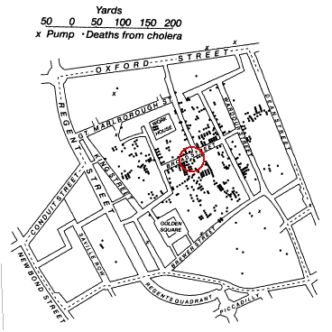
GIS Before Computers
Cholera Map of Dr. John Snow (UK 1850s)

